Slide 1
Just 3 Dudes
By: Logan Rosser, Kaleb Maulding, Connor Ostrowski

Slide 2
Doom Like Game
Will be a single player FPS shooter
Gonna have different types of enemies
Player shoots the enemies and wins if they defeat them all
Player has set health and loses when it hits zero
Pick Up medkit to heal
Using Python
Notes:
eee

Slide 3
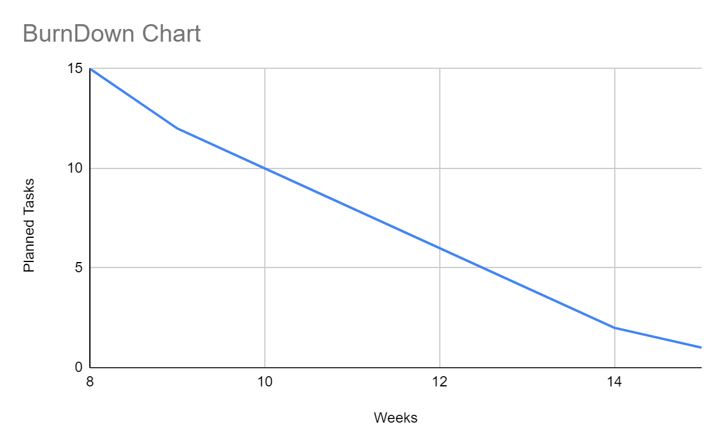
BurnDown Chart
-15 tasks to complete over 8 weeks
-major tasks are creating 3D environment using raycasting algorithm
-Creating enemy pathfinding algorithm
-implementing player movement
-implementing damage and health mechanics for player and enemy
Notes:
-Using Math and Map to create a 3d environment

Slide 4
Software
Possible Features
Health regen
Scoreboard
Multiple guns
Multiple levels
Pack A Punch system
Ammo features
We are using pygame
Using math and map library
Importing sprites
Importing audio

Slide 5
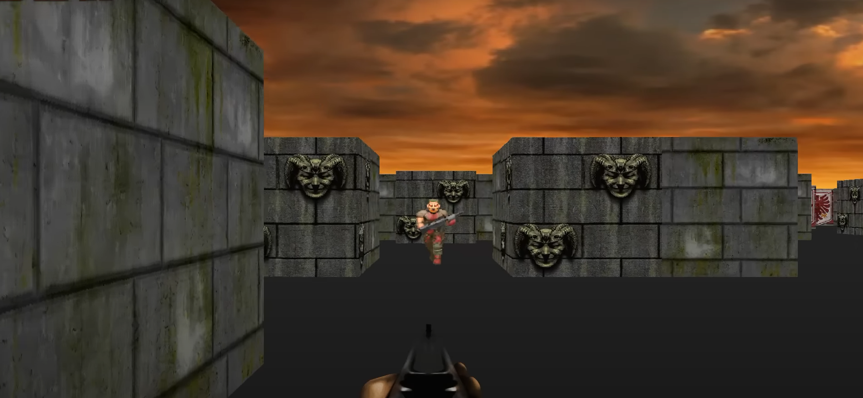
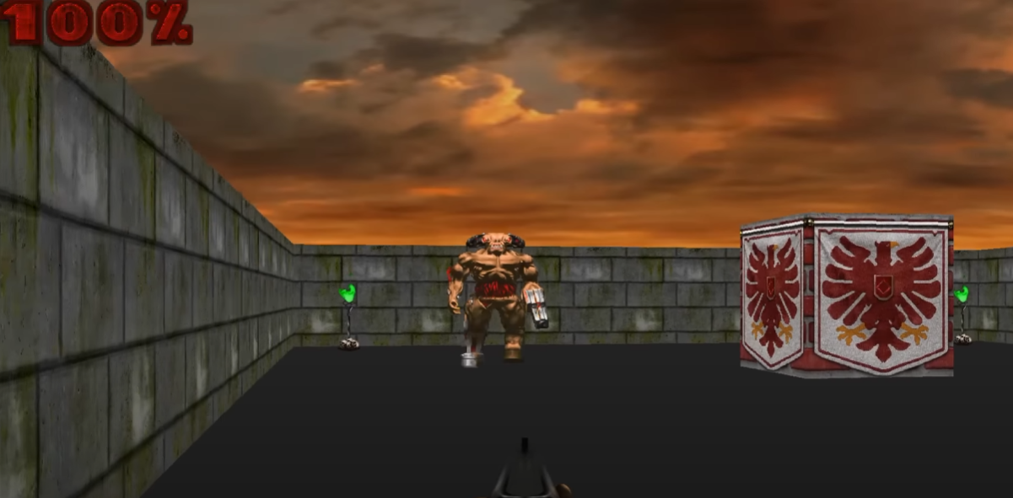
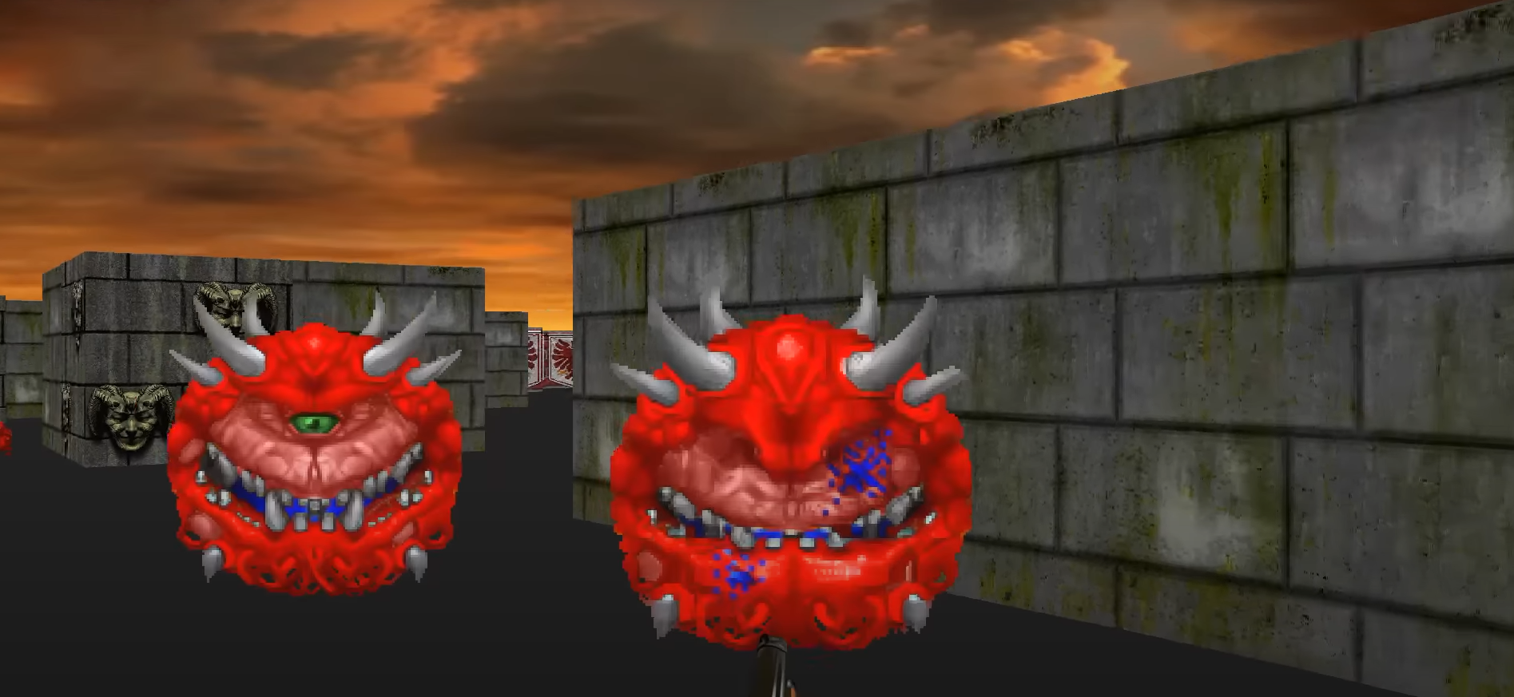
Preview of Final Product
Notes:
eee

